Slide 1
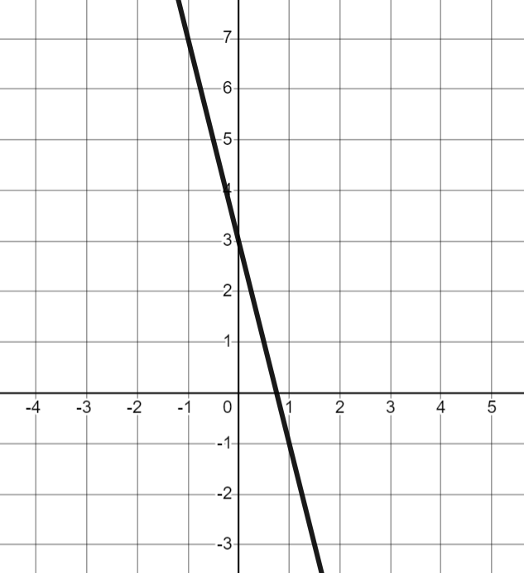
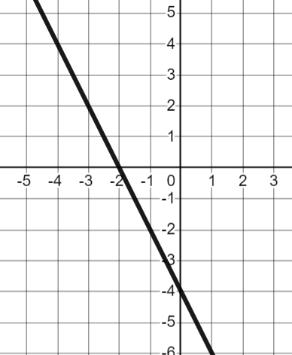
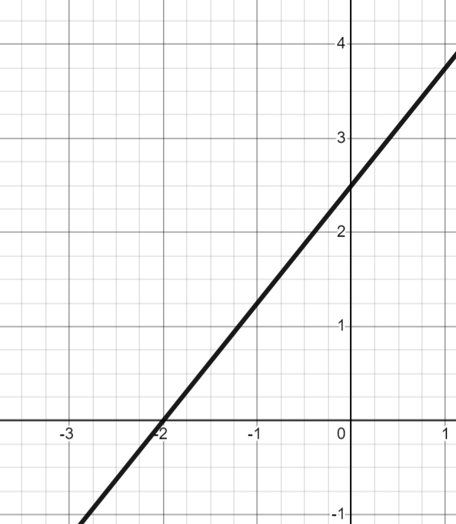
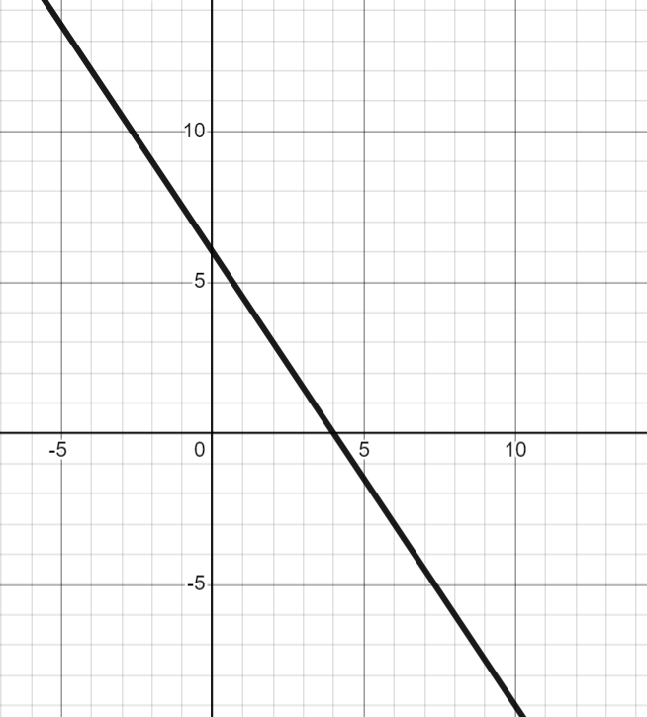
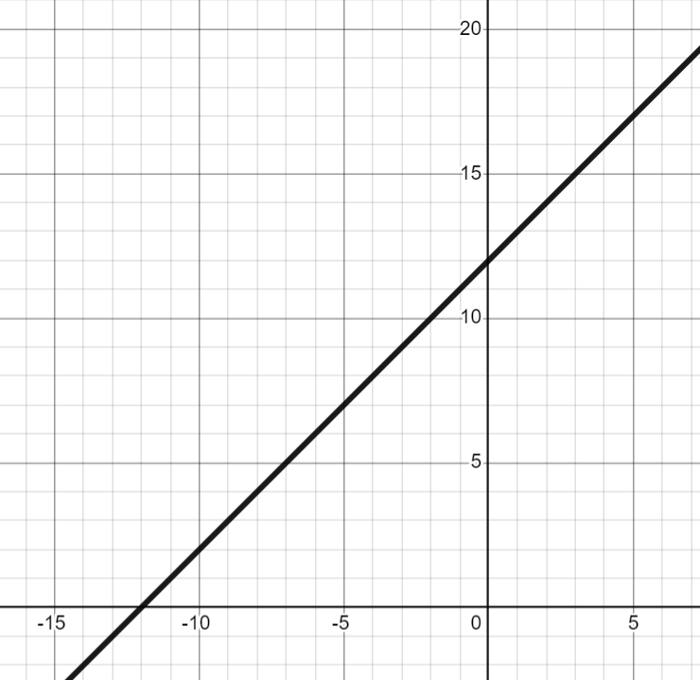
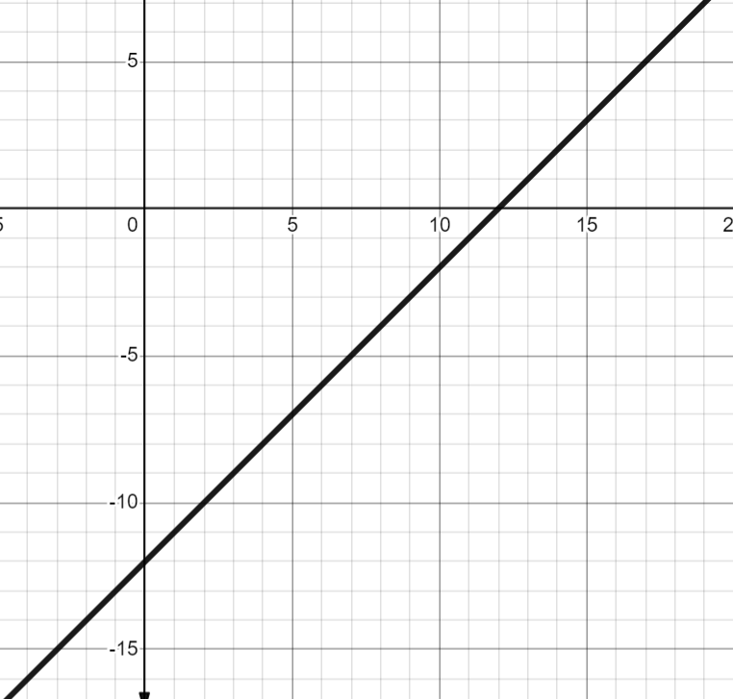
The intercept point
Task A: Identifying the y-intercept
1) For each question, circle the y-intercept on the graph and in the table.
a) | b) | c)
x | 0 | 1 | 2 | 3
y | 3 | −1 | −5 | −9
x | −2 | −1 | 0 | 1
y | 0 | −2 | −4 | −6
x | −2 | 0 | 2 | 4
y | 0 | 2.5 | 5 | 7.5
2) Write the y-intercept for each as a coordinate.
(0,3)
(0,−4)
(0,2.5)
3) Match each y-intercept to a graph, a table and an equation.
A (0,6)
B (0,12)
C (0,−12)
E
D
F
G
x | 0 | 2 | 4
y | 6 | 3 | 0
H
x | −10 | −5 | 0
y | 2 | 7 | 12
I
x | −1 | 0 | 1
y | −13 | −12 | −11
L
2y + 3x − 12 = 0
J
y = x + 12
K
y + 12 = x

Slide 2
The intercept point
Task B: Calculating the y-intercept from tables of values
For each table of values, work out the y-intercept.
a)
b)
c)
x | 0 | ….. | 2 | 3 | 4
y | 7 | ….. | 13 | 16 | 19
(0,7)
x | 0 | ….. | 6 | 7 | 8
y | 7 | ….. | 19 | 21 | 23
(0,7)
x | 0 | ….. | 25 | 26 | 27
y | -83 | ….. | 17 | 21 | 25
(0,−83)
d)
e)
f)
x | 0 | ….. | 10 | 11 | 12
y | 47 | ….. | −3 | −8 | −13
(0,47)
x | −5 | −4 | −3 | ….. | 0
y | 15 | 12 | 9 | ….. | 0
(0,0)
x | −12 | −11 | −10
y | −21 | −15 | −9
(0,51)

Slide 3
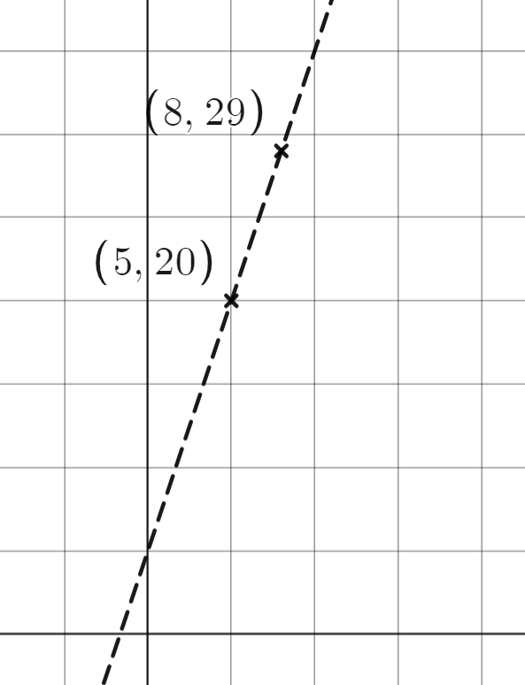
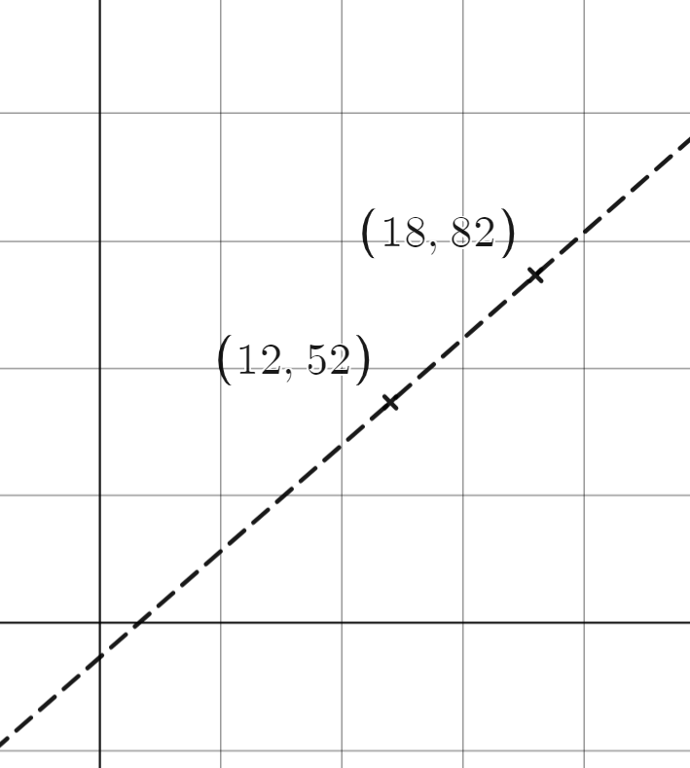
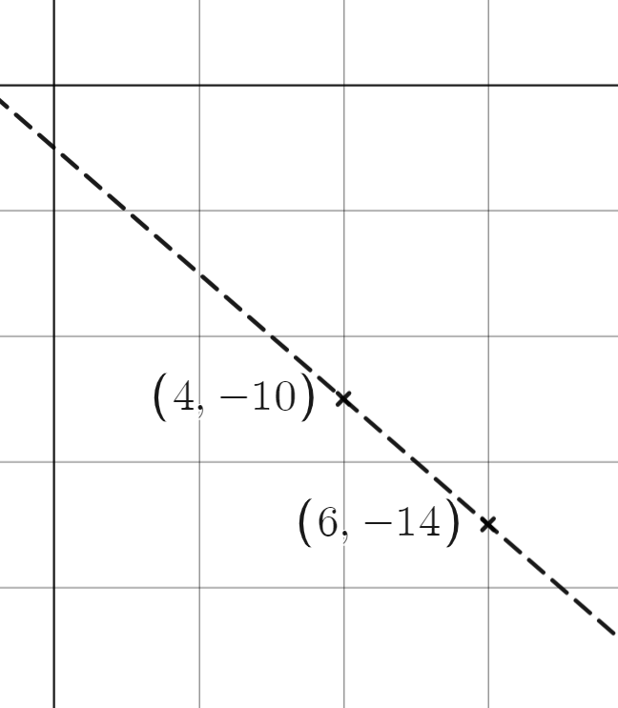

The intercept point
Task C: Calculating the y-intercept from two coordinates
1) For each pair of coordinates, work out the y-intercept for the line which passes through them.
a) (5, 20) and (8,29) | b) (12,52) and (18,82) | c) (4,−10) and (6,−14)
3 | 9
1 | 3
6 | 30
1 | 5
2 | −4
1 | −2
gradient = 3
gradient = 5
x | 0 | ….. | 5 | ….. | 8
y | 5 | ….. | 20 | ….. | 29
x | 0 | ….. | 12 | ….. | 18
y | −8 | ….. | 52 | ….. | 82
x | 0 | ….. | 4 | ….. | 6
y | −2 | ….. | −10 | ….. | −14
y-intercept = (0,5)
y-intercept = (0,−8)
y-intercept = (0,−2)
d) (10,8) and (18,0) | e) (7,54) and (10,75) | f) (6,13) and (9,22)
8 | −8
1 | −1
3 | 21
1 | 7
3 | 9
1 | 3
gradient = 7
gradient = 3
x | 0 |  | 10 | ….. | 18
y | 18 |  | 8 | ….. | 0
x | 0 |  | 7 | ….. | 10
y | 5 |  | 54 | ….. | 75
x | 0 |  | 6 | ….. | 9
y | −5 |  | 13 | ….. | 22
y-intercept = (0,18)
y-intercept = (0,5)
y-intercept = (0,−5)
Mathematics in Education and Industry
v2.2

